Slide 1
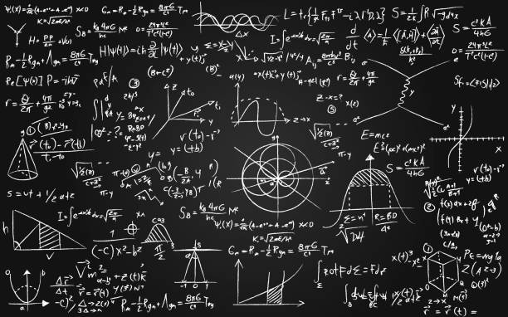
The Undisciplined Mathematician: A Portfolio Career in Mathematical Sciences
The Undisciplined Mathematician:
My career in Mathematical Sciences
Dr. Eugenie Hunsicker
AGQ Student Conference
University of Glasgow
4 November 2025

Slide 2


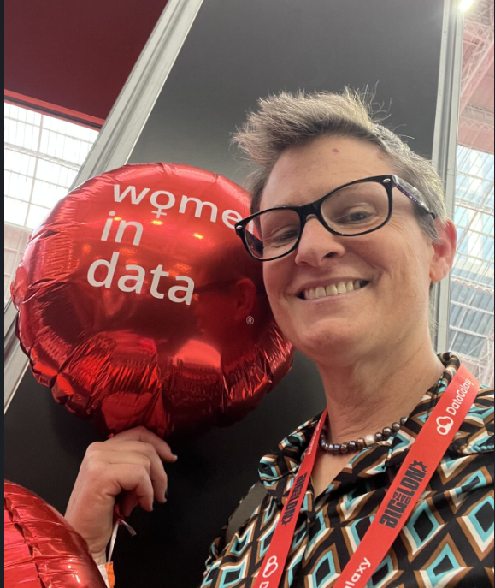

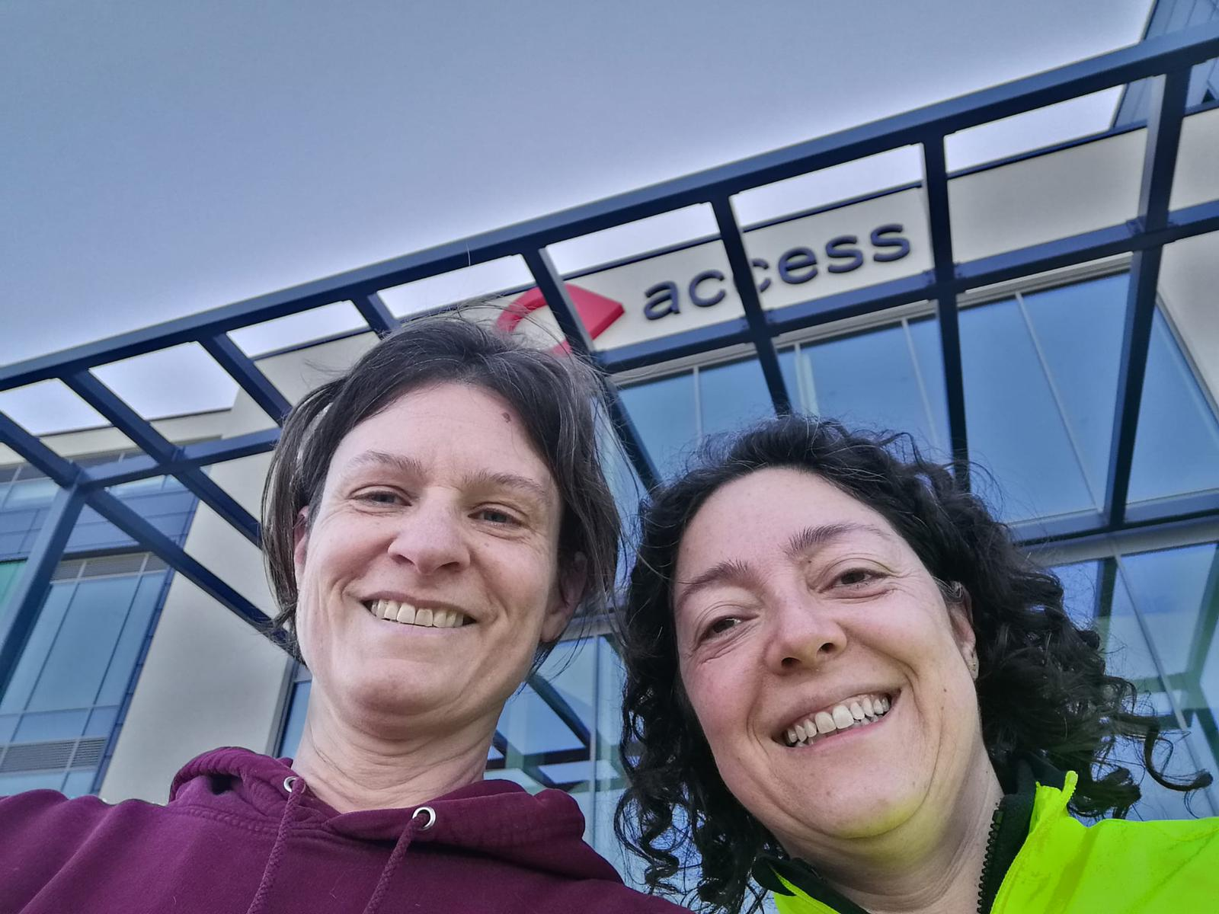
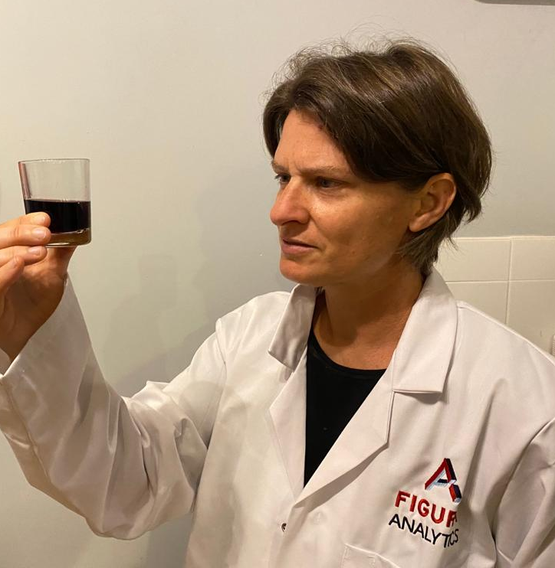
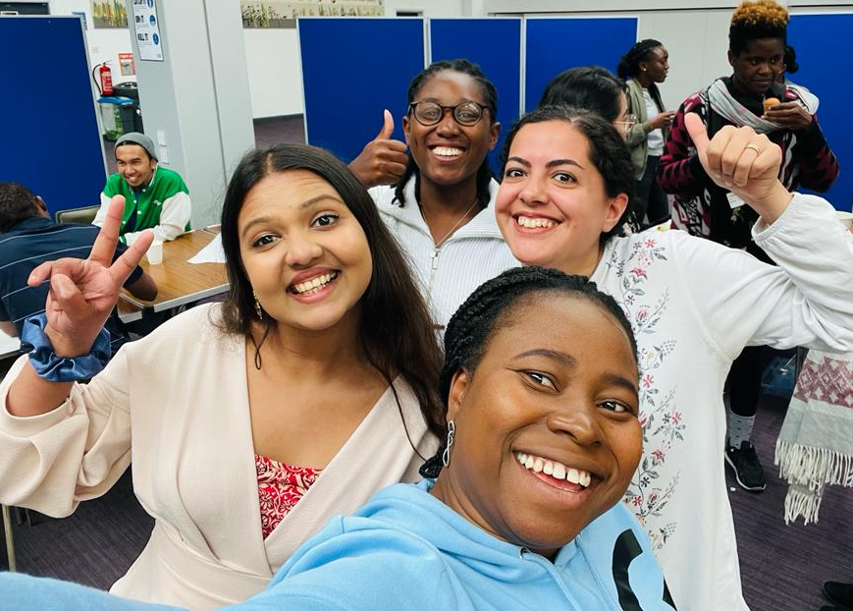
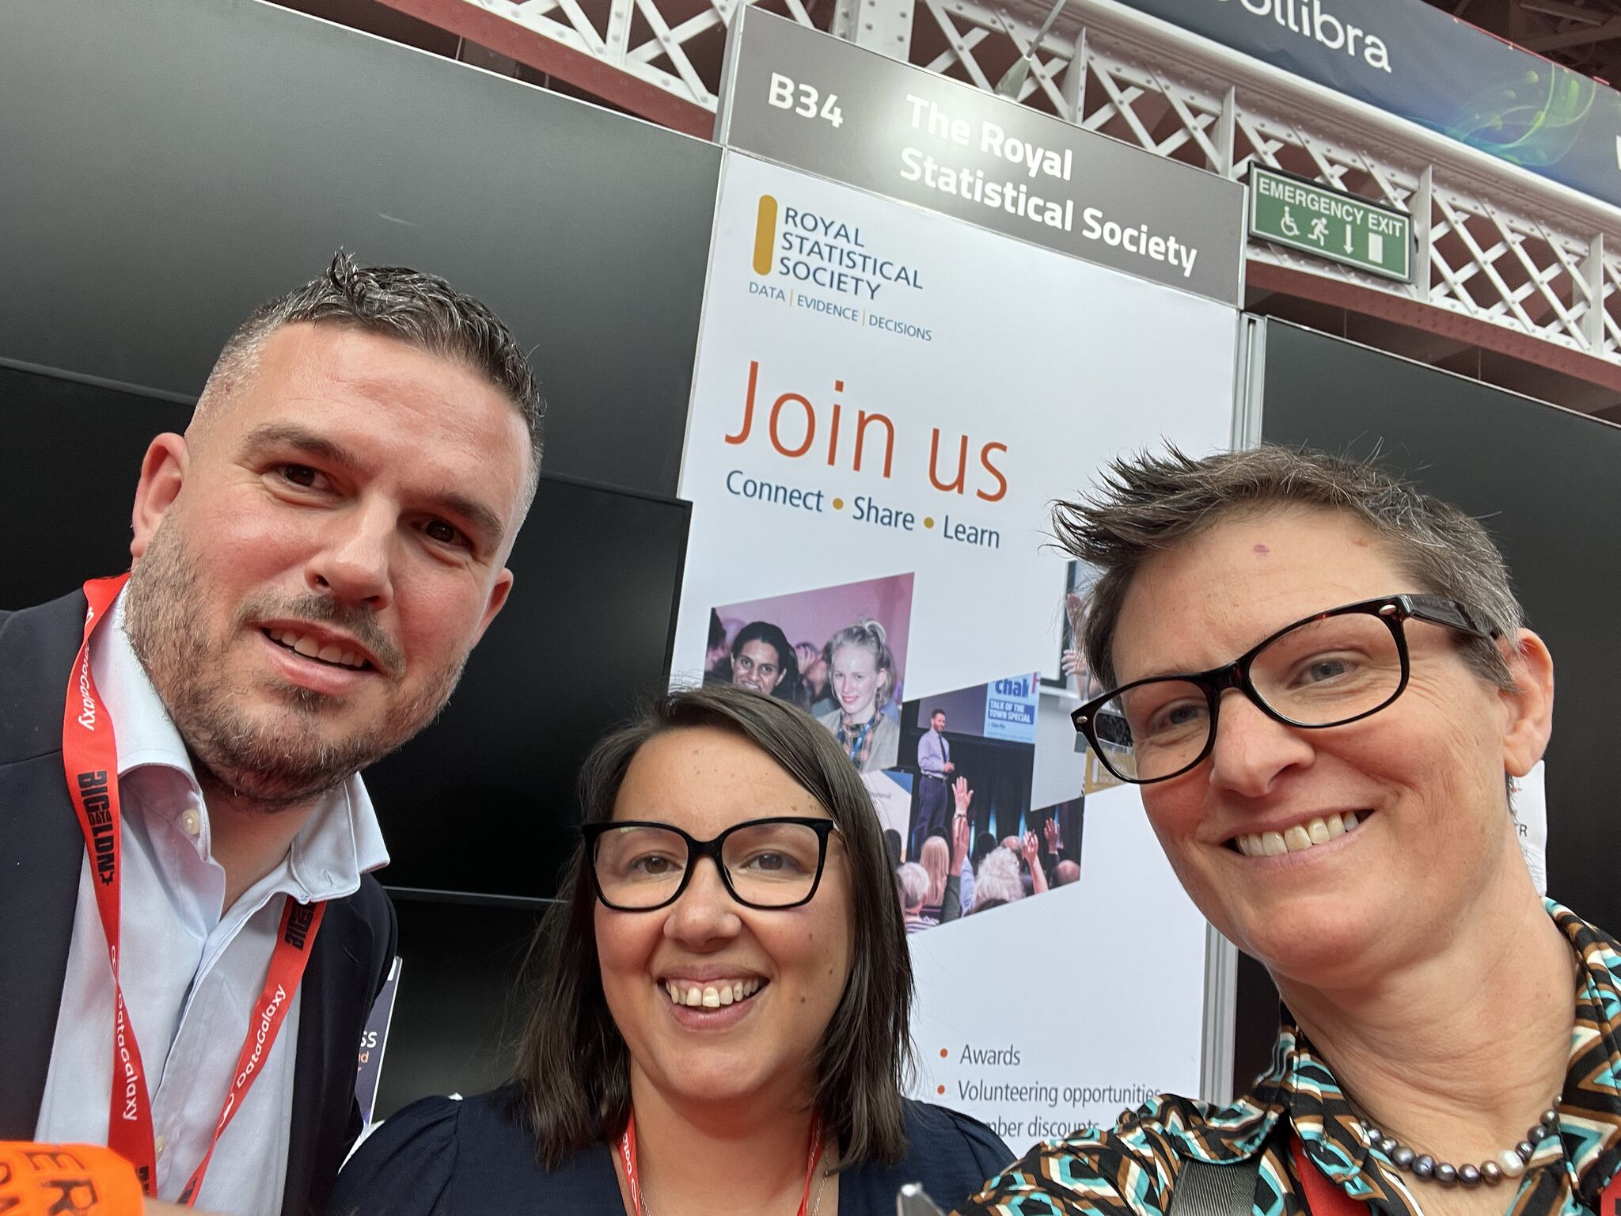



Slide 3
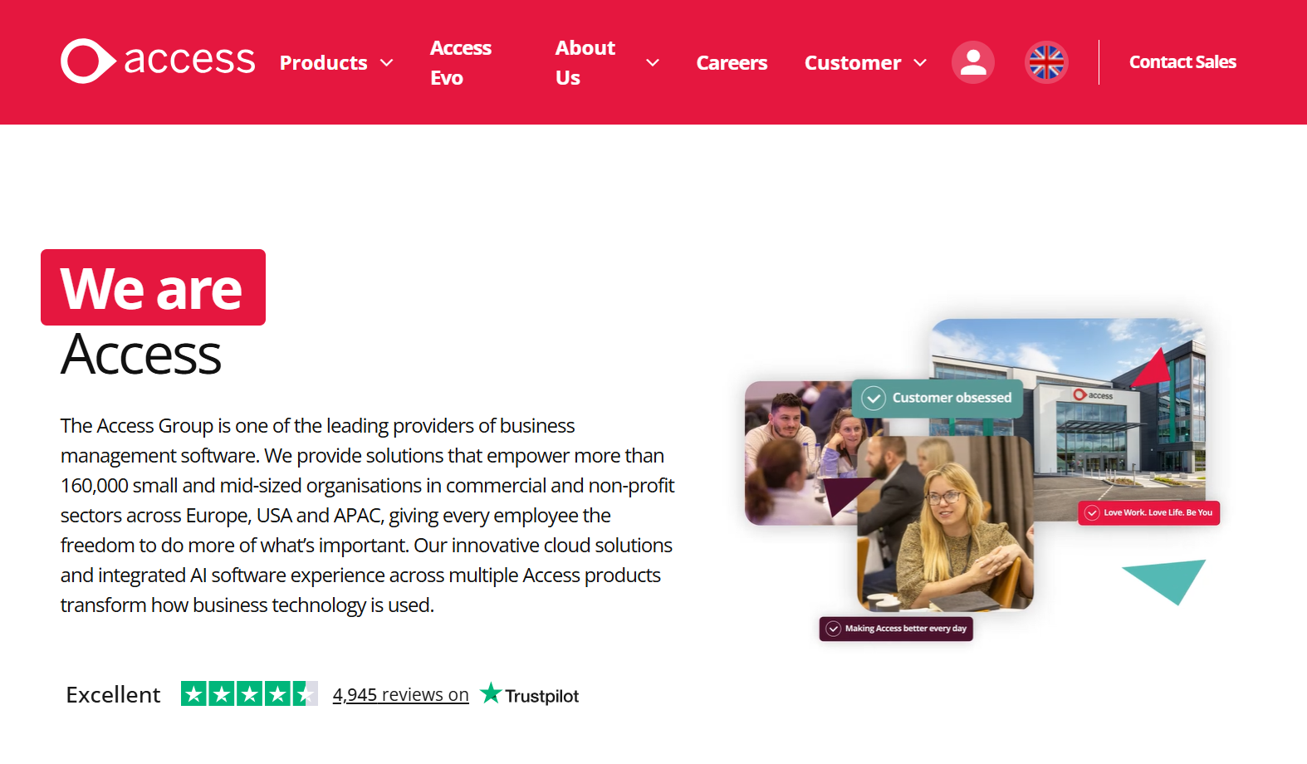

Slide 4
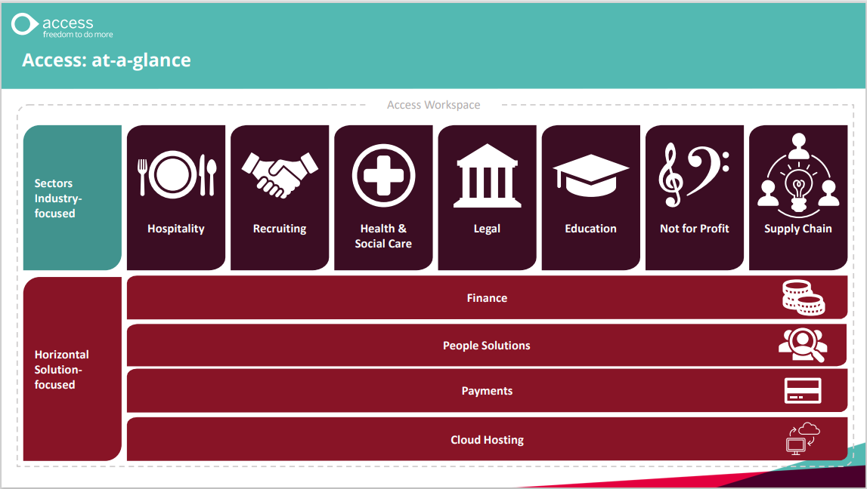

Slide 5
Sales and Marketing
Customer Success
Group Technology Services
Finance
Employee Success
Products & Engineering
Employee Platforms
Marketing Platforms
Customer Platforms
Data Solutions
InfoSec
IT
Finance Platforms
Data Engineering
Data Management Office
Data Science
BI & Data Analytics
Head of Data Science
Lead Data Scientist
Data Scientist
Data Scientist
Associate Data Scientist
Data Developer
Data Developer

Slide 6
Sales and Marketing
Customer Success
Group Technology Services
Finance
Employee Success
Products & Engineering
Employee Platforms
Marketing Platforms
Customer Platforms
Data Solutions
InfoSec
IT
Finance Platforms
Data Engineering
Data Management Office
Data Science
BI & Data Analytics
Head of Data Science
Solution Architect?
Data Scientist
Data Scientist
Associate Data Scientist
Data Developer
Data Developer

Slide 7
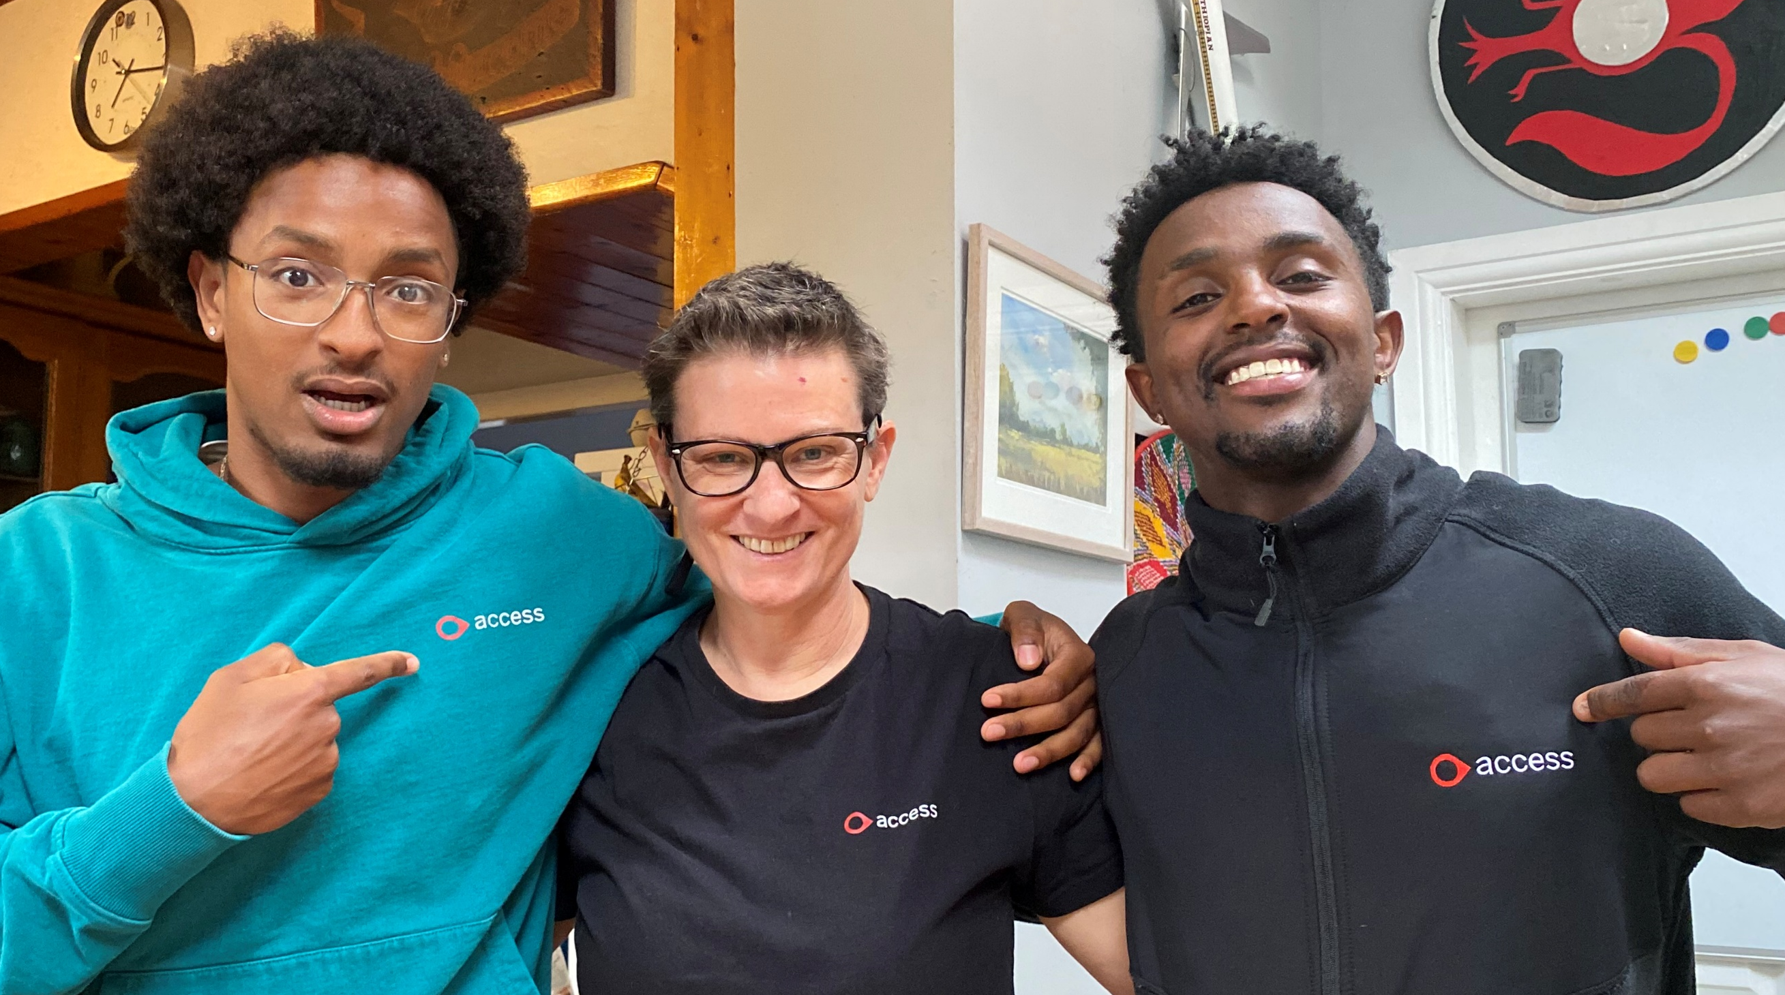
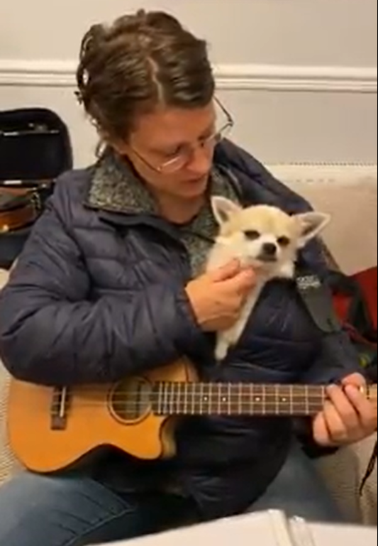
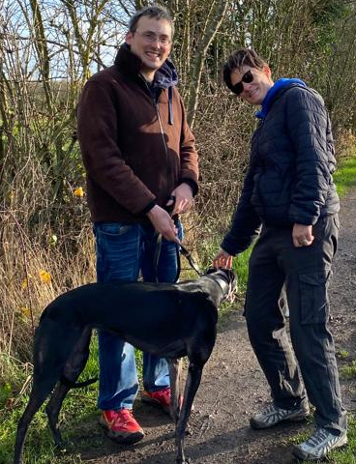
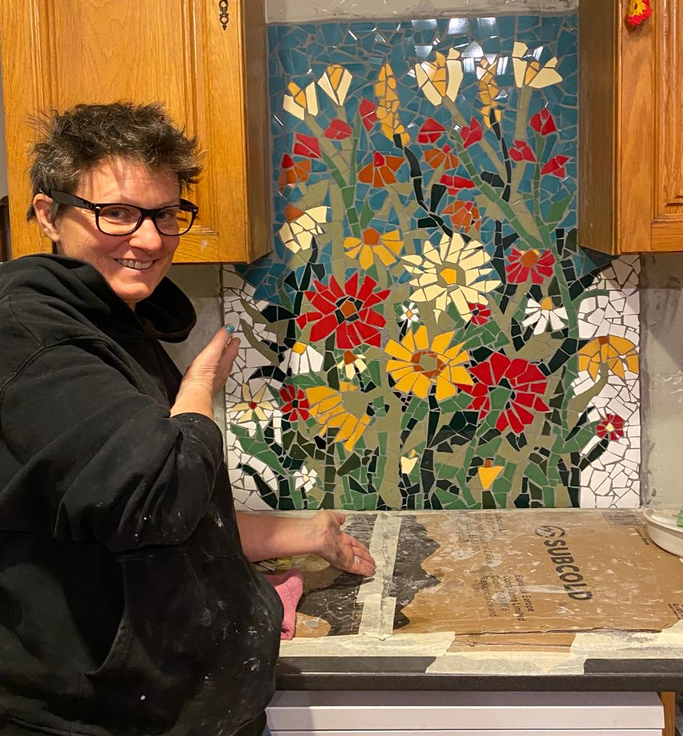
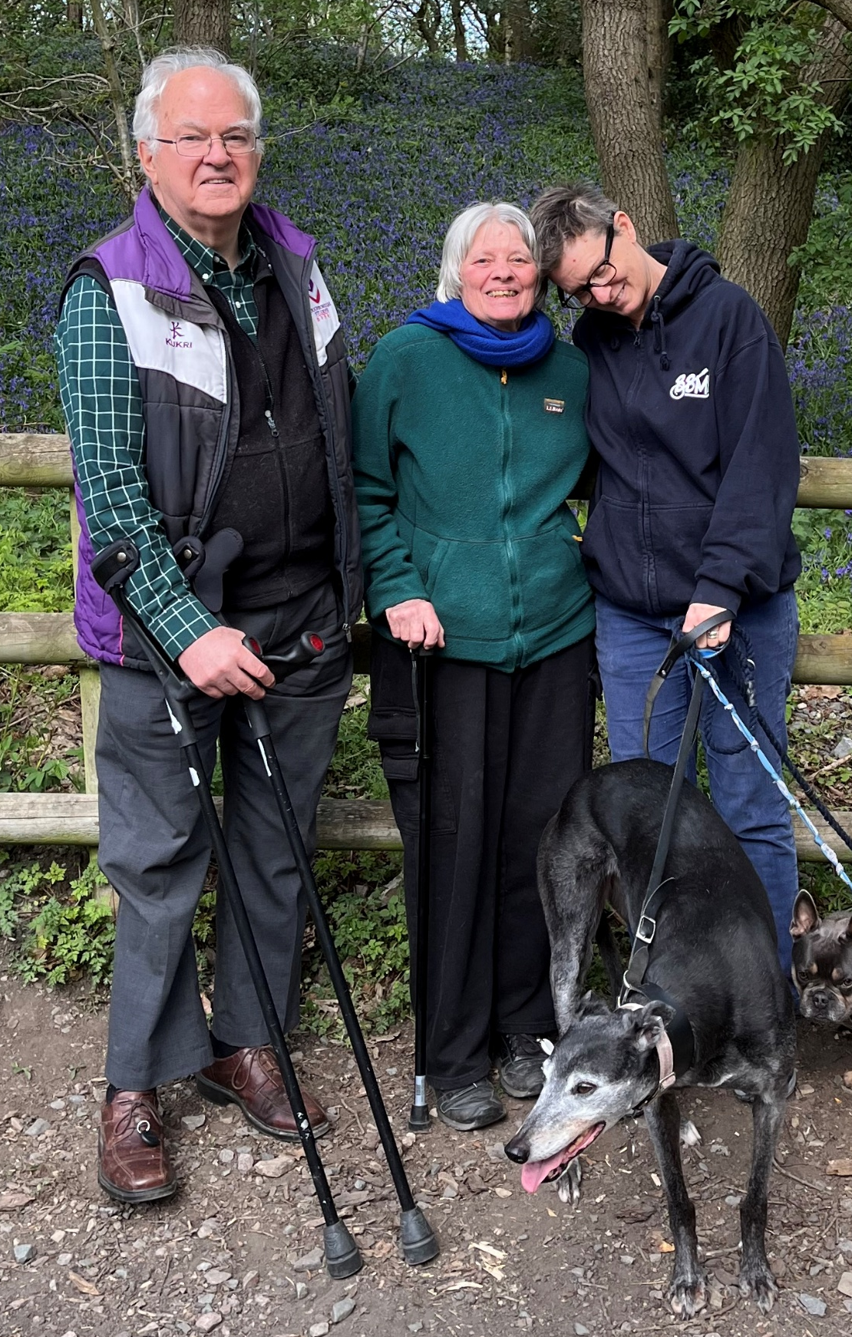
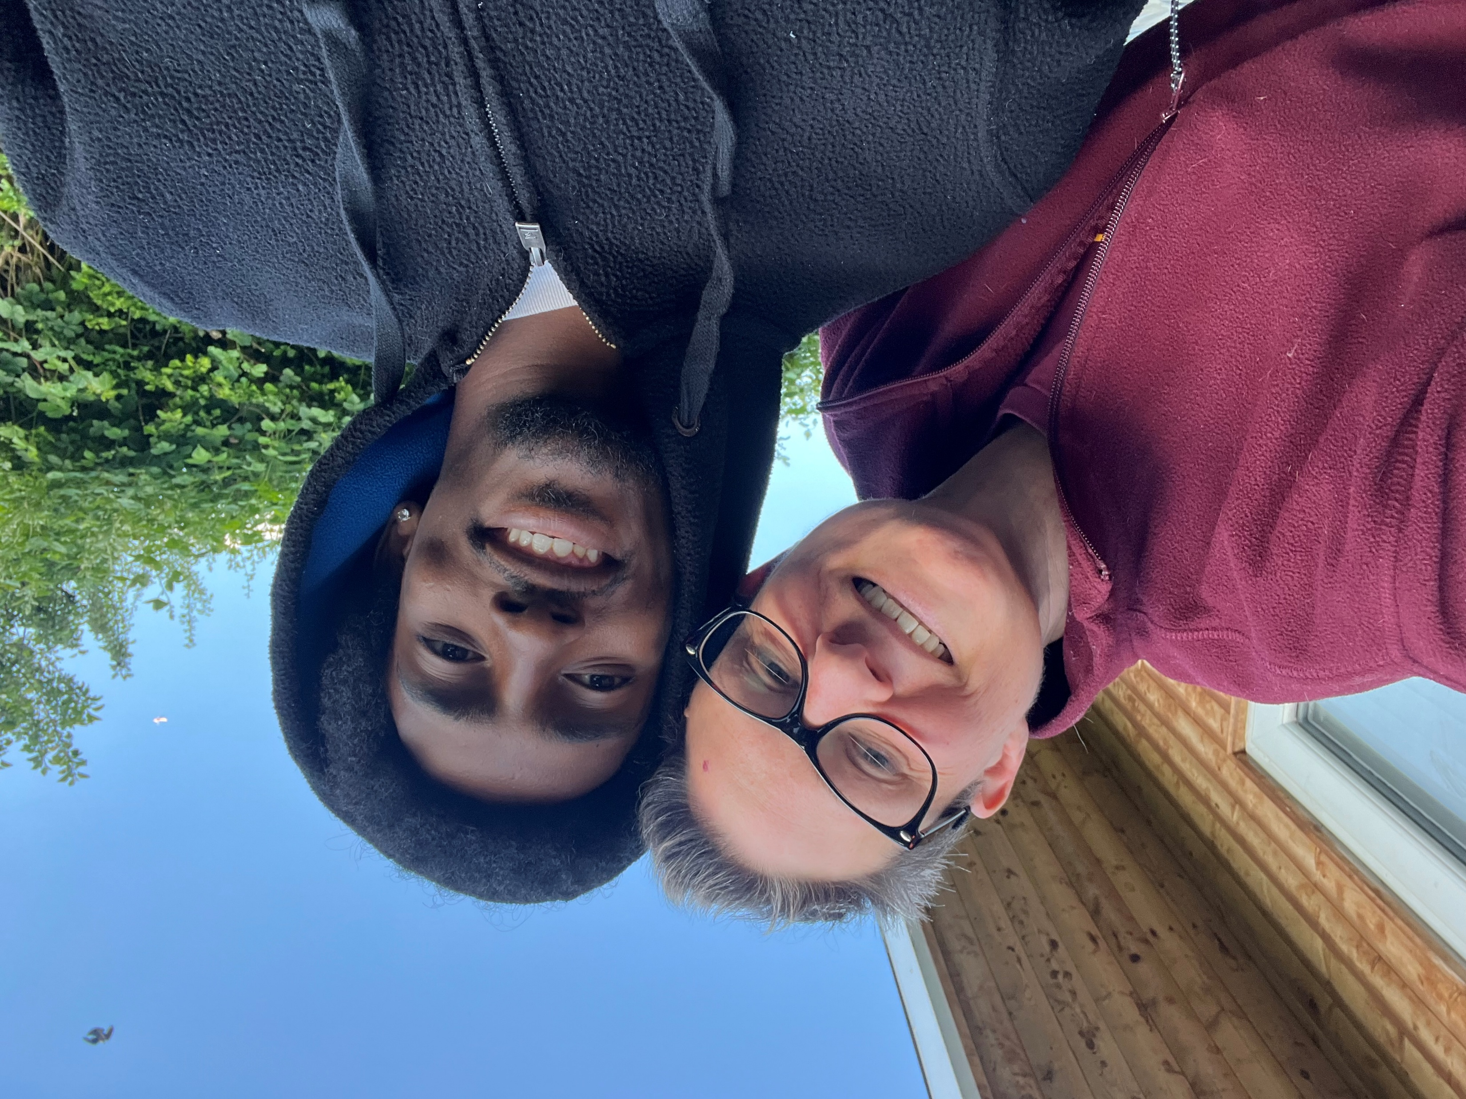

Slide 8
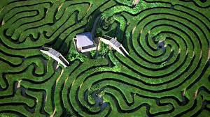
How did I get here?

Slide 9

The Myth of the Mathematical Life Course
In “Women Becoming Mathematicians”, Margaret Murray talks about “The Myth of the Mathematical Life Course”, which is characterised by early recognition of talent and an uninterrupted path to professional success.
We hear this narrative often in citations for mathematical prizes.
This is not the story of my life.

Slide 10
My CV
1992
BSc. Mathematics (Magna Cum Laude, Phi Beta Kappa); Haverford College
1999
PhD in Mathematics; University of Chicago
1999–2005
Assistant Professor of Mathematics, Lawrence University, Wisconsin, USA
2005–2006
Associate Professor of Mathematics, Lawrence University, Wisconsin, USA
2006–2015
Lecturer in Mathematics, School of Science, Loughborough University
2015-2022
Senior Lecturer in Mathematics, School of Science, Loughborough University
2010
Adoption leave, started change of research area
2022
Lead Data Scientist, The Access Group
2022
Reader in Mathematics, Loughborough Uni

Slide 11
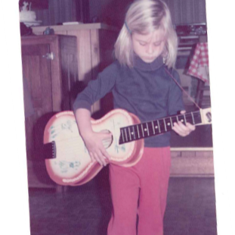
Ages 5-12: I wanted to be a Palaeontologist

Slide 12
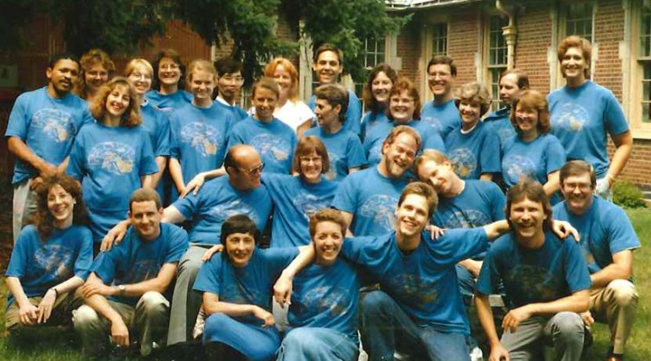

Ages 12-19: I wanted to be a doctor—maybe a psychiatrist

Slide 13
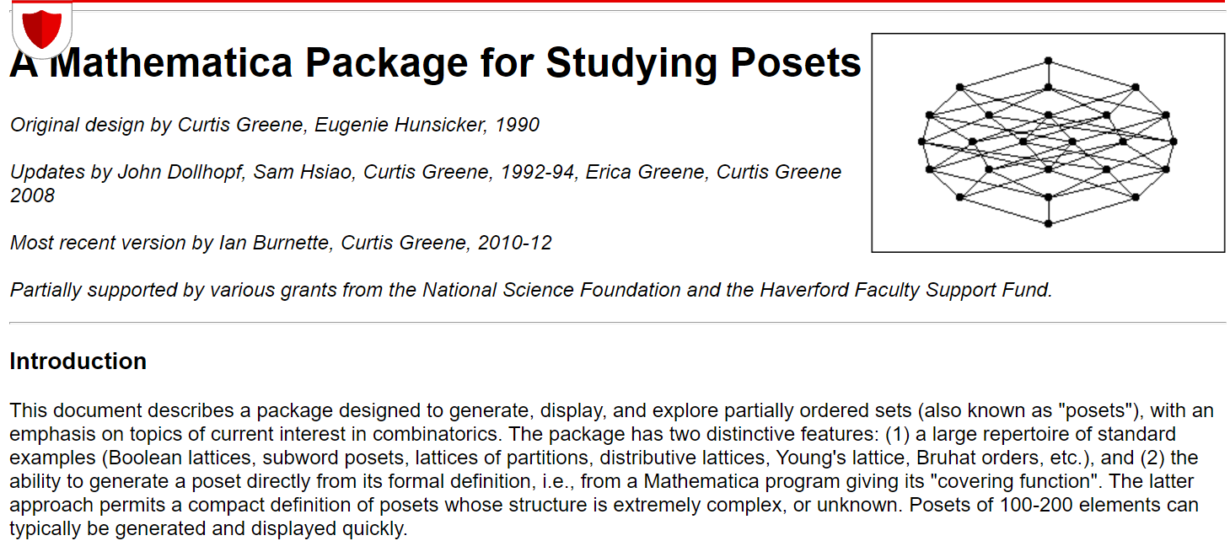
During my undergraduate degree: computational combinatorics
Notes:
My favourite parts of this work were the visual aspect of it—making beautiful diagrams that also gave insights and the emergence of surprising equalities.

Slide 14
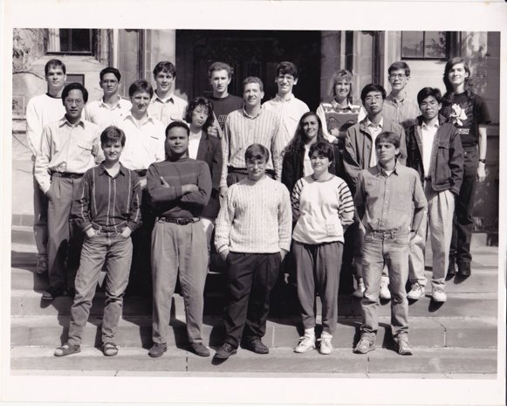

Age 22, starting my PhD. My mom asks, “What are you going to do with a Mathematics PhD?”
I wasn’t sure.

Slide 15
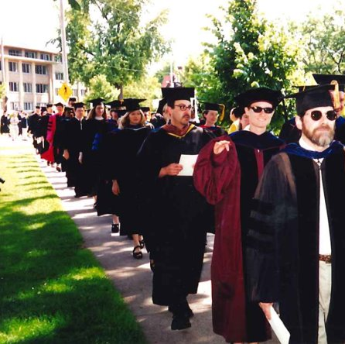
Working at a liberal arts (teaching intensive) university
Notes:
Working at a liberal arts college was fun. I got to talk to academics from all different areas, from history to drums to art to geology. I even got to teach a crazy wide range of topics in Freshman Studies. But also after I left grad school and could start working collaboratively, I grew more interested in research, and wanted to go somewhere I could spend more time on it.

Slide 16
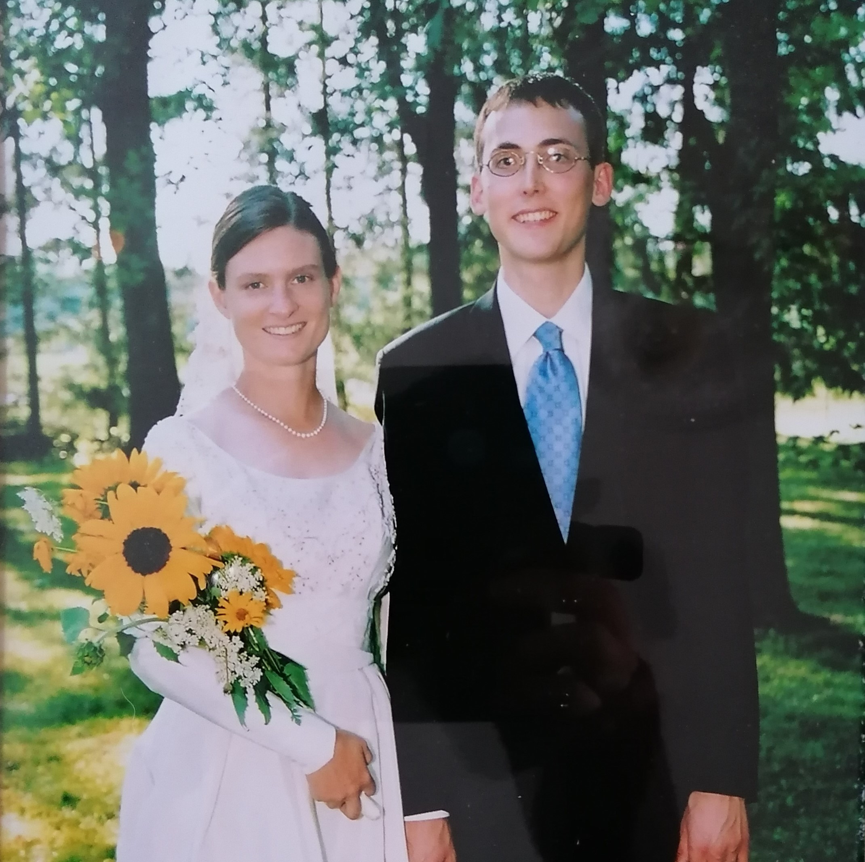
So…
Tenure and promotion, spring 2005,
Married Summer 2005,
MOVED to the UK in July 2006 to start over as a lecturer again at Loughborough University.

Slide 17



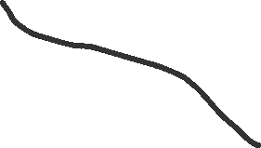



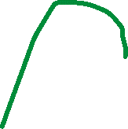



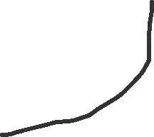

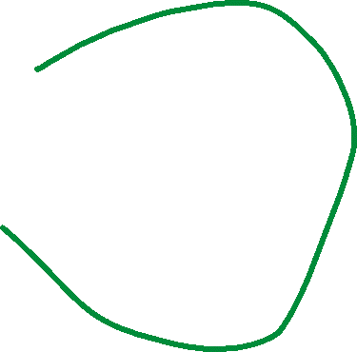

Branching out, or trying to put down new roots?
2006 - 2010
Singular Finite
Element Methods
Topology of
Stratified Spaces
Pseudodifferential
Operator theory
Hodge Theorems
Notes:
Now that I had more time for research, I was looking to branch out. I worked in some areas around the things I had done before, expanding the underpinning techniques and looking for applications beyond string theory. I found the last one discouraging. Everyone talked vaguely about applications, but nobody seemed able to pin down a specific and impactful one. But other things were afoot that took precedence in my life.

Slide 18
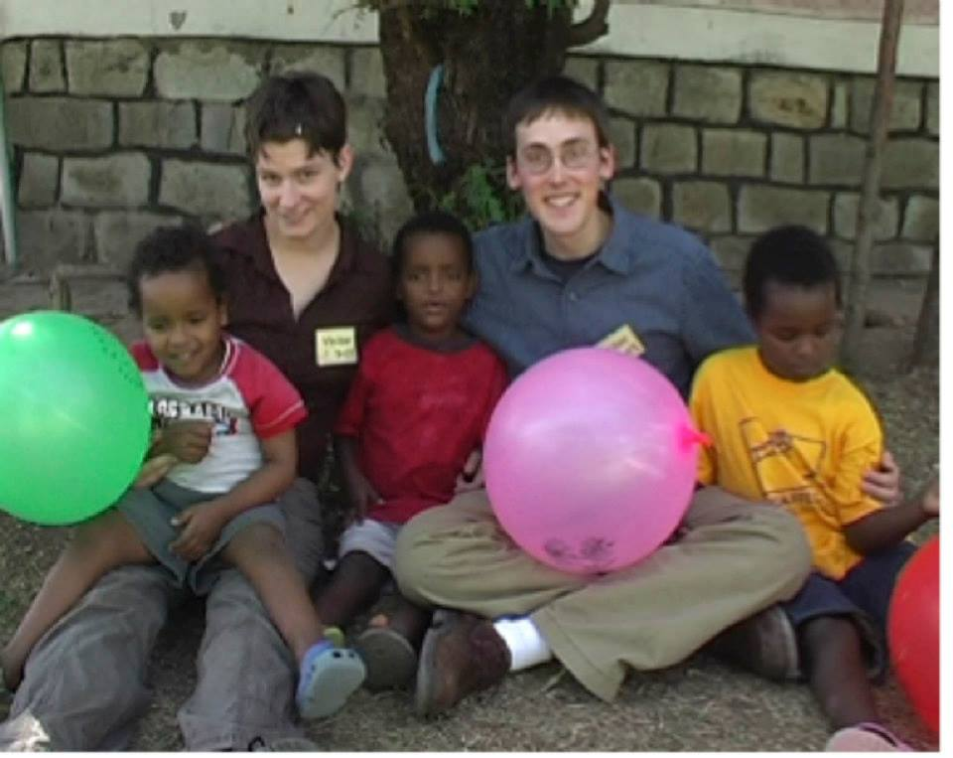
Insta-family!
Adoption spring 2010 + 1 year adoption leave
Turns out being a mum takes a lot of time and energy
And it is hard to find extended periods of time to concentrate

Slide 19

2011-2015
Jumping Across the Chasm: transitioning from pure mathematics to applied statistics

Slide 20
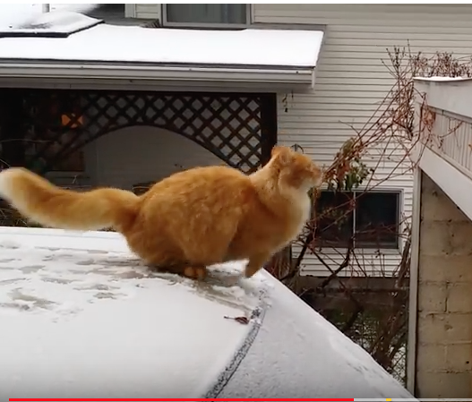
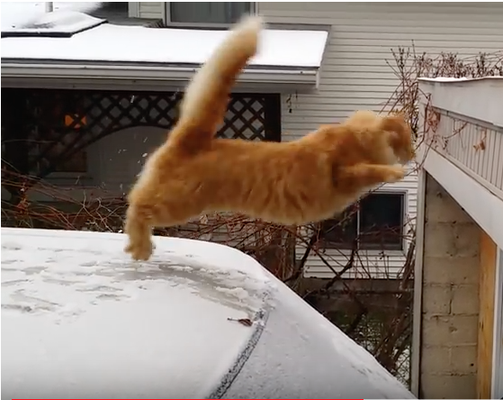
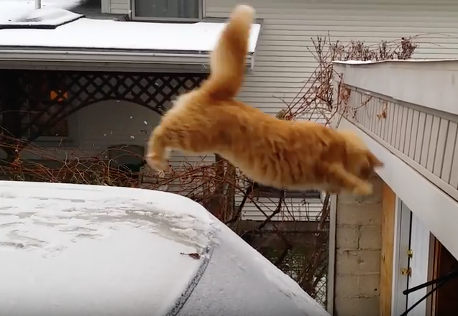
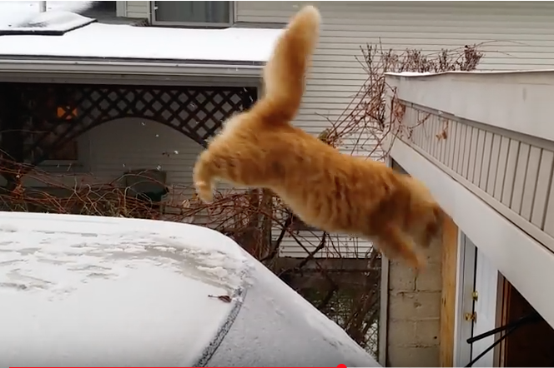
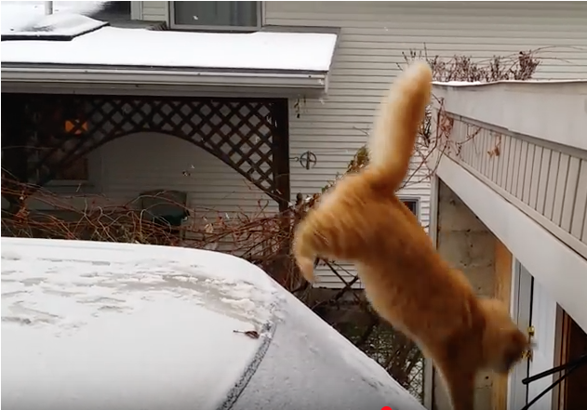
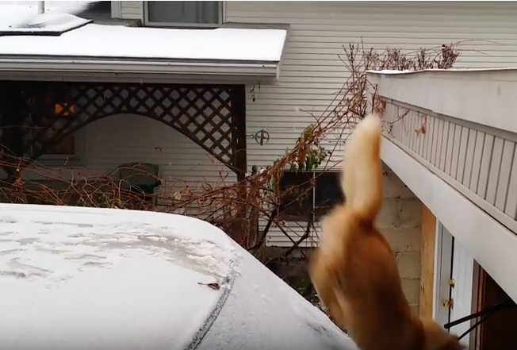


Slide 21
A timeline of change
2011: Start teaching (and learning!) undergraduate applied statistics, become programme director for new Mathematics with Statistics programme
Summer 2012: HEA Teaching Development Grant: Undergraduate summer research project to develop online resources and teaching materials
2012-13: Five final year undergraduate projects in different statistics topics
Summer 2013: Another undergraduate research project to develop online statistics resources, funded by Loughborough Teaching Innovation Award
2015-16: Developing research collaborations
2016: First PhD students in statistics, failed grant application
2017: First publications, another new PhD student, first consulting project
2018: Another new PhD student, another unsuccessful grant application

Slide 22
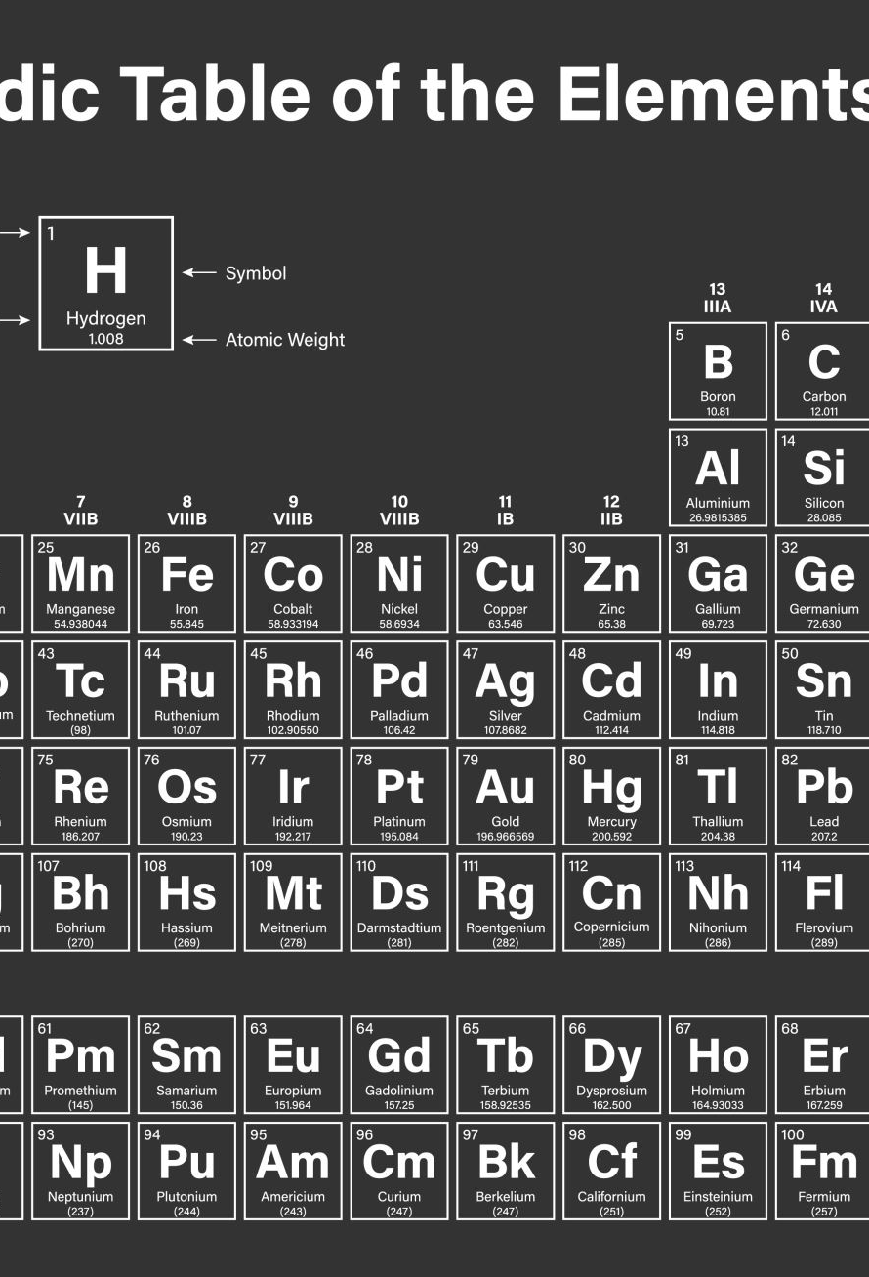
2019: Resistive pulse sensing
Originally a method of counting particles in solution, previous work to determine size distributions and charge
Industrial motivation: Current nanoparticle characterisation and quality control methods are slow, expensive and cannot be done in solution
Goal: extract real time shape data for particles in solution from nanopore signals (transition from a counting to an imaging method)

Slide 23
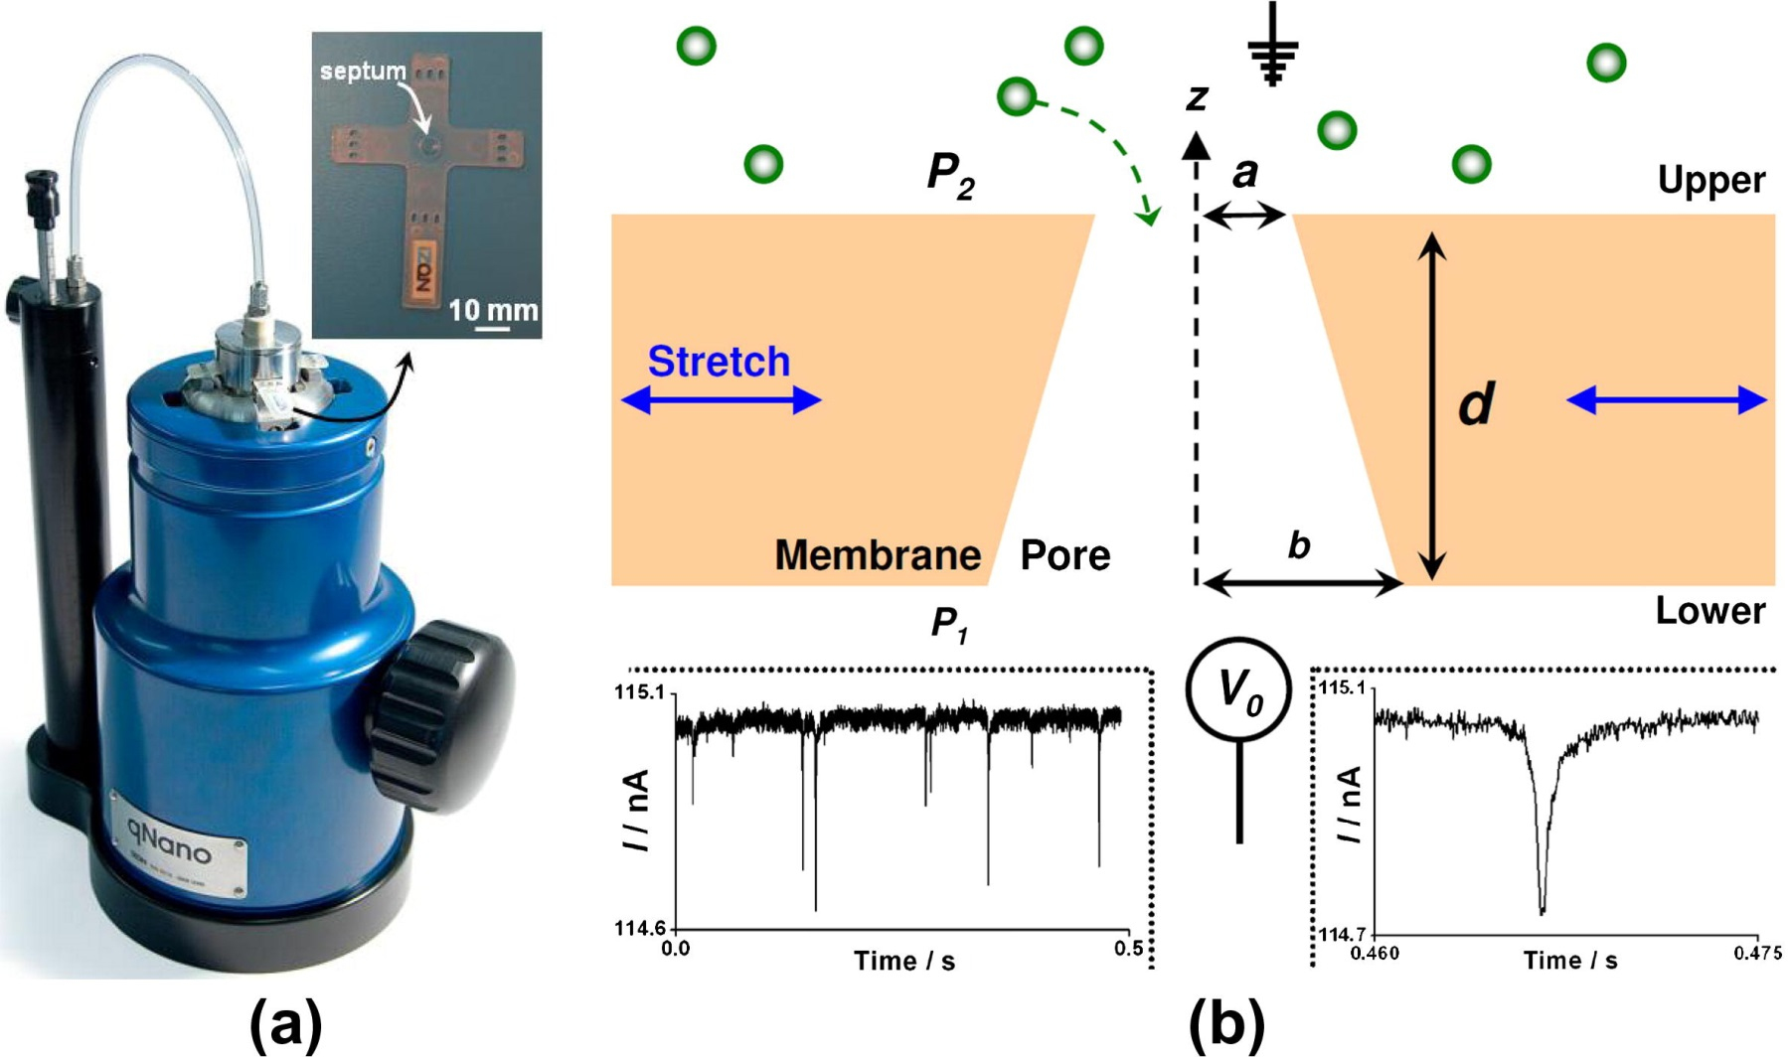
Somerville et al, 2013, https://doi.org/10.1016/j.jcis.2012.11.071

Slide 24
Statistical Metrology
Many of the questions my colleagues came to me with or that I found boiled
down to a question about measurement.
How can I reliably measure shape? Chemical composition?
Anatomical variation? Dysfunctional breathing?
We often imagine we are measuring an external and intrinsic property,
but quite often, the system defines the measurement, and there isn’t any “ground truth” to compare to.
How do we define measurements that are repeatable? Precise? Predictive
of relevant outcomes?

Slide 25
Doing impactful data science is a lot about stakeholder engagement
Listen to and respect people with different knowledge and background to yours
Allow their questions to be the ones that drive the work forwards, and your experience to steer it through the rough terrain
Focus on how to solve the problem, not how to use the shiniest, fanciest new tools.
What you are like as a person is as or more important
than how much you know and how smart you are.

Slide 26
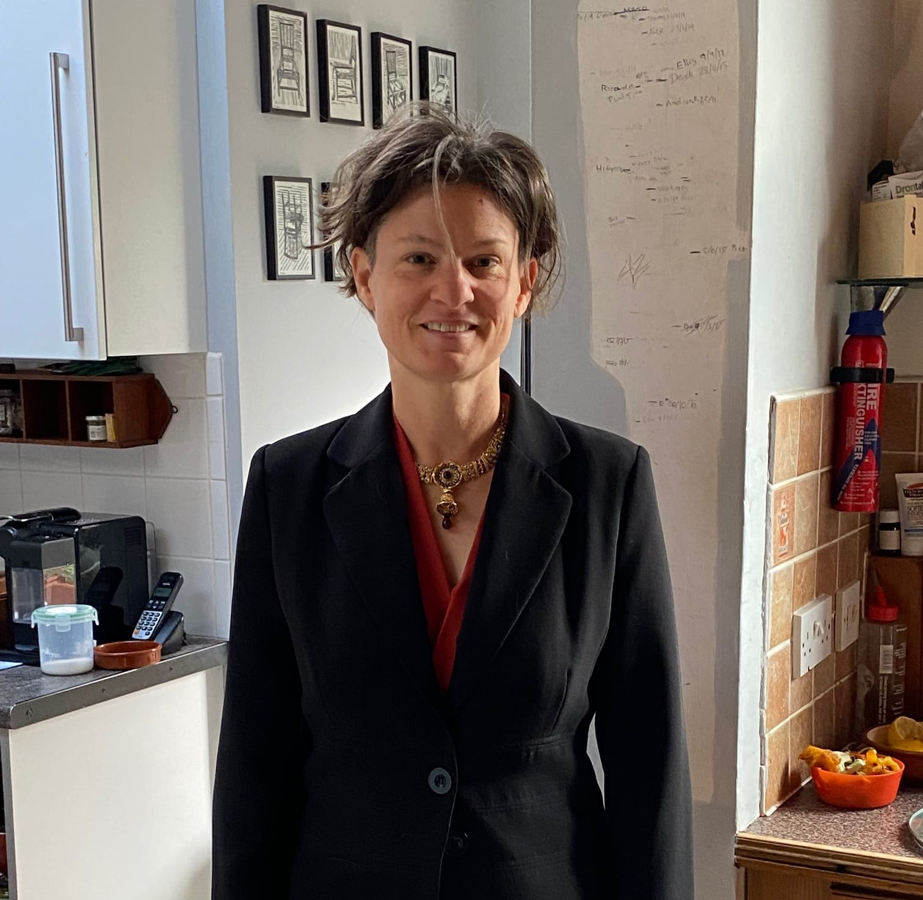
2022: Transition to Industry
Notes:
I started to realise that the things that motivated me now--solving practical problems, making sure things worked over and over again reliably, thinking strategically about where the main bottlenecks and obstructions were in a process—these were the types of things that were actually better aligned with an industrial career than an academic one.

Slide 27
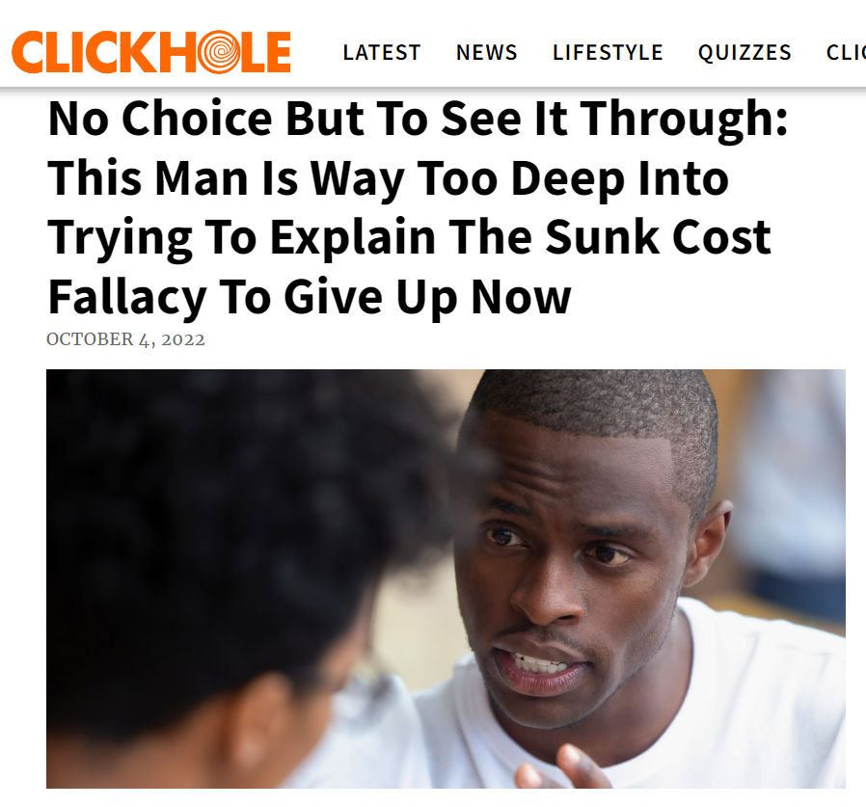
Notes:
Some people ask, “Why would you leave an academic career when you were just promoted?”
Don’t fall for the Sunk Cost Fallacy in your career!

Slide 28
In summary
My unfocussed career has spanned teaching, pure mathematics, metrology and applied data science, and has involved three employers across two countries.
Data science wasn’t even a thing when I was a graduate student.
My choices have been influenced by curiosity and a desire to have an impact in the world, but also by changes in my personal life.
I am also not the same person I was when I was in graduate school.

Slide 29
Some hard-won wisdom
Academia as it existed 20 years ago doesn’t exist anymore and is unlikely to exist in the foreseeable future

Slide 30
Some hard-won wisdom
Academia as it existed 20 years ago doesn’t exist anymore and is unlikely to exist in the foreseeable future
The secret to loving your job is not to find the perfect job. It is to be curious and interested in a wide range of things, to love learning and to enjoy working with different people in different contexts.

Slide 31
Some hard-won wisdom
Academia as it existed 20 years ago doesn’t exist anymore and is unlikely to exist in the foreseeable future
The secret to loving your job is not to find the perfect job. It is to be curious and interested in a wide range of things, to love learning and to enjoy working with different people in different contexts.
Management is hard. Anywhere you work, the people in management above you do not have the power or influence you think they have. Learn to work with them to create change where possible, and to adapt to circumstances where it is not.

Slide 32
Some hard-won wisdom
Academia as it existed 20 years ago doesn’t exist anymore and is unlikely to exist in the foreseeable future
The secret to loving your job is not to find the perfect job. It is to be curious and interested in a wide range of things, to love learning and to enjoy working with different people in different contexts.
Management is hard. Anywhere you work, the people in management above you do not have the power or influence you think they have. Learn to work with them to create change where possible, and to adapt to circumstances where it is not.
Don’t avoid stress, uncertainty or periods of intense work. Although you shouldn’t only experience these, your ability to navigate periods of them successfully is what makes you valuable and will keep you happy.

Slide 33


Slide 34
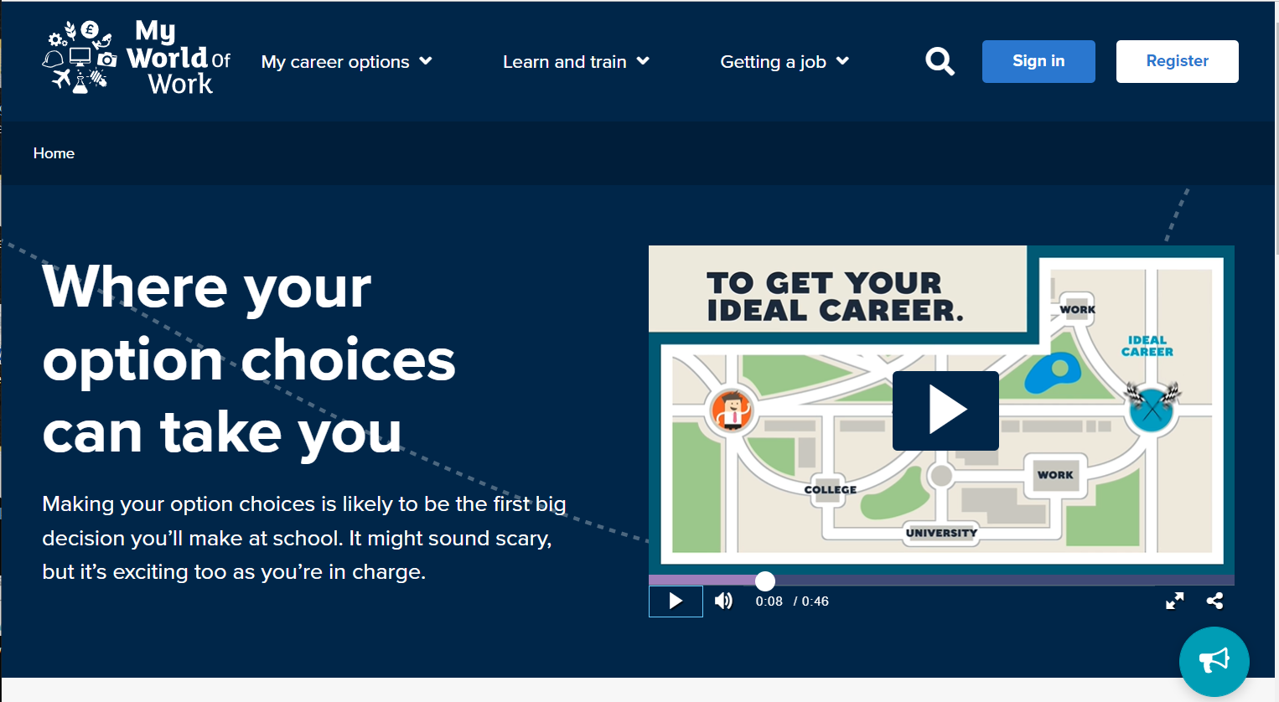

Slide 35
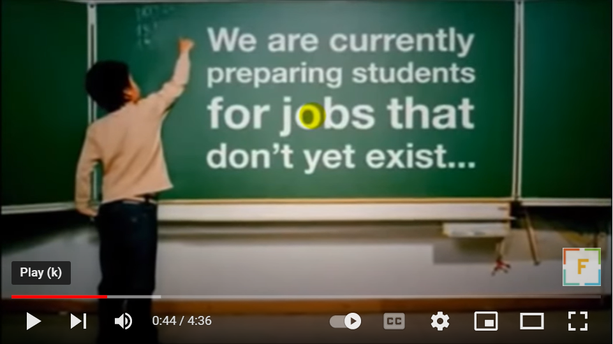

Slide 36
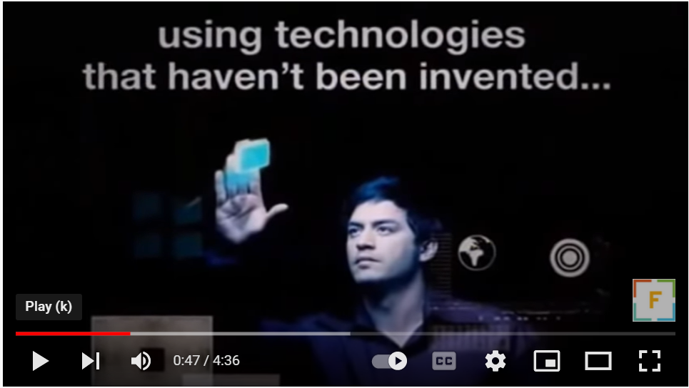

Slide 37
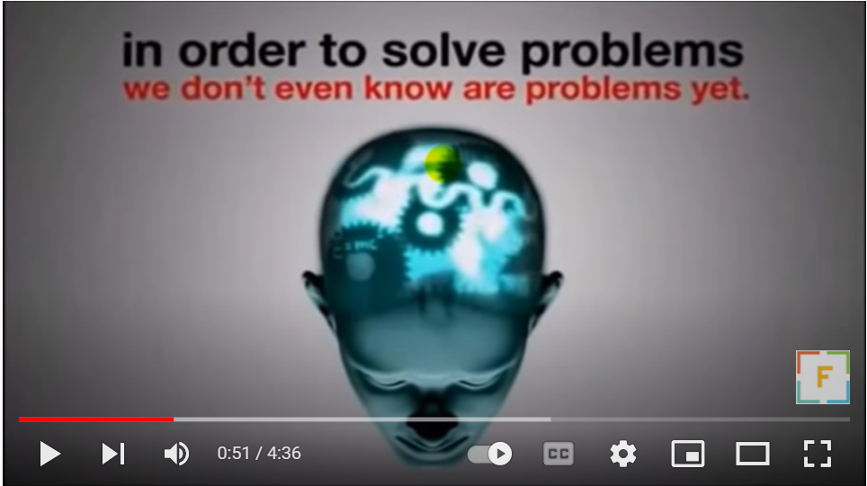
Did You Know (Officially updated for 2022) #2022 - YouTube

Slide 38
Don’t get hung up on “the ideal career” you are aiming for.
Just choose something you think might be interesting for the next few years, and keep your eyes open for new opportunities that seem cool.

Slide 39

BUT…
If you learn how to think analytically, communicate well and tackle hard questions and uncertainty without getting intimidated, you will have plenty of cool paths to take!

